Slide 1
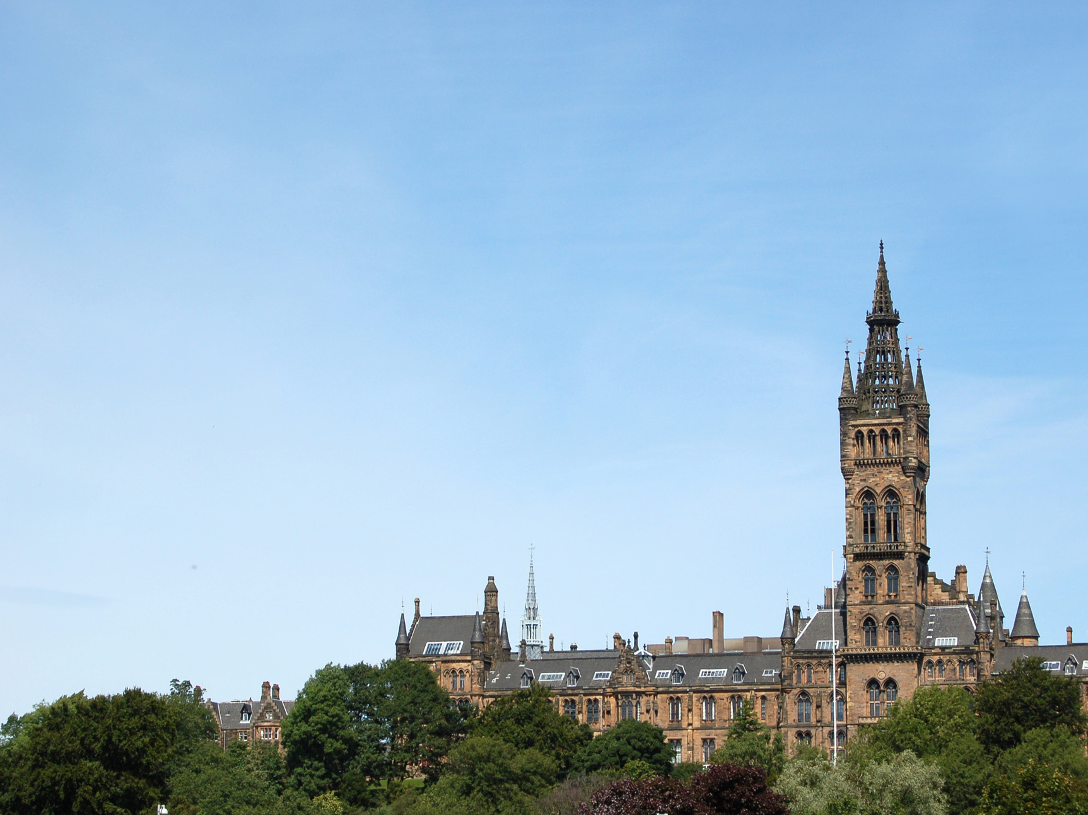
Can we Legislate for Gifted Education?
Kai Zhang
k.zhang.2@research.gla.ac.uk

Slide 2
What is Gifted Policy
Gifted policy is the collection of laws ,rules and guidelines that govern the operation of gifted education systems
Educational policy’s conceptualisation as a linear process of policy formulation thus policy is an active process that constantly changes
(Francis, 2012)

Slide 3
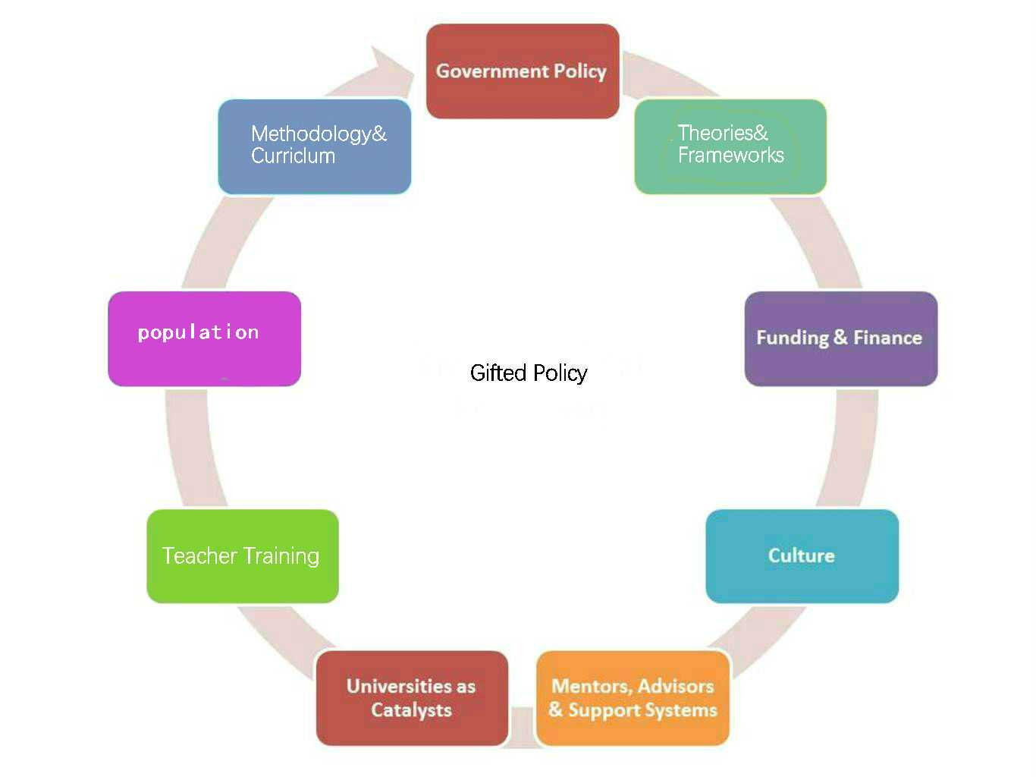
What is Gifted Policy
Reviewing the Place of gifted education in local education

Slide 4
What is it for
Setting goals is not easier than achieving goals of policy, as various agents are involved in the formulation of the policy
Murphy, 2012
Who is involved in the process of policy making and in
what ways?
How the policy is interpreted by different agents?

Slide 5
How does it work
“One policy doesn't work without the other. They need to come together holistically”
(Clark ,2013)

Slide 6
How does it work
The Standards in Scotland’s School, etc. (2000)
“the development of the personality, talents and mental and physical abilities of the child to their fullest potential” (Section 2)
(for example, the European Union, the World Bank, the International Monetary Fund, the United Nations, the Organisation for Economic Cooperation and Development, etc.
1948, United Nations Declaration of Universal Human Rights
“everyone has a right to education”
1994, the Salamanca Statements
focused on educational equity for those with special educational needs
A Curriculum for Excellence
(was designed to enable schools to develop their own content and pedagogy to meet perceived local needs, thus providing an appropriate curriculum for individual learners)
Getting it Right for Every Child Approach
（was designed to ensure that all children receive appropriate and timely support when it is required）

Slide 7
Reference
Baker, B. D. (2001). Gifted children in the current policy and fiscal context of public education: A national snapshot and state-level equity analysis of Texas. Educational Evaluation and Policy Analysis, 23(3), 229-250.
Baldwin, A. Y. (2004). Culturally diverse and underserved populations of gifted students (Vol. 6). Corwin Press.
Francis, B., & Mills, M. (2012). What would a socially just education system look like?. Journal of Education Policy, 27(5), 577-585.
Gallagher, J. J. (2004). Public policy in gifted education (Vol. 12). Corwin Press.
Long, L. C., Barnett, K., & Rogers, K. B. (2015). Exploring the relationship between principal, policy, and gifted program scope and quality. Journal for the Education of the Gifted, 38(2), 118-140.
Murphy, K. (2012). The social pillar of sustainable development: a literature review and framework for policy analysis. Sustainability: Science, Practice, & Policy, 8(1).
Renzulli, J. S., & Reis, S. M. (Eds.). (2004). Identification of students for gifted and talented programs. Corwin Press.
Swanson, J. D. (2007). Policy and practice: A case study of gifted education policy implementation. Journal for the Education of the Gifted, 31(2), 131-164.

